Slide 1
WORK MOTIVATION
PRABESH ADHIKARI

Slide 2

Motivation
The degree to which and individual chooses to engage in certain specified behavior
Organization and its member’s relation is influenced by what motivates them to work

Slide 3
Characteristics
Direction and Persistence of action
Typified as Individual Phenomenon
Described as Intentional
Multifaceted
Arousal (What gets people activated?)
Choice of Behavior

Slide 4
Concept of Motivation
Behavior is determined by what motivates them
Performance is product of ability level and motivation
Performance = ability * motivation

Slide 5
Performance
Ability
Motivation
Environment
Performance is the function of interaction between individual’s ability, motivation and environment

Slide 6
Basic Motivation Model
NEEDS/
EXPECTATIONS
DRIVING FORCE
(behavior/action)
DESIRED GOALS
result in
to achieve
feedback
FULFILMENT
which provide

Slide 7
12 Human Needs
Family
Health and Well-being
Work/career
Economic Stability
Learning
Home/Shelter
Social Relationships
Spirituality
Community
Leisure
Mobility
Environment and Safety

Slide 8
Theory of Motivation
Motivation is complex subject.
Personal thing and influenced by many variables
Money as Motivator
Fulfillment of twelve human needs
Work and private life are two new millennium to revolve around 12 human needs

Slide 9
Intrinsic Motivation
Psychological Rewards such as:
A sense of challenge and achievement
Receiving appreciation
Opportunity to use one’s ability
Positive recognition
Being treated in caring and considerate manner
Determined by action and behave of individual manager

Slide 10
Extrinsic Motivation
Tangible Rewards such as:
Salary and fringe benefits
Promotion
Security
Contract of Service
Work Environment
Conditions of work
Determined by outside the control of manager

Slide 11
Developing Passion for Work
Eight critical employee needs
Meaningful Work
Collaboration
Fairness
Autonomy
Recognition
Growth
Connectedness with leaders
Connectedness with Colleagues

Slide 12
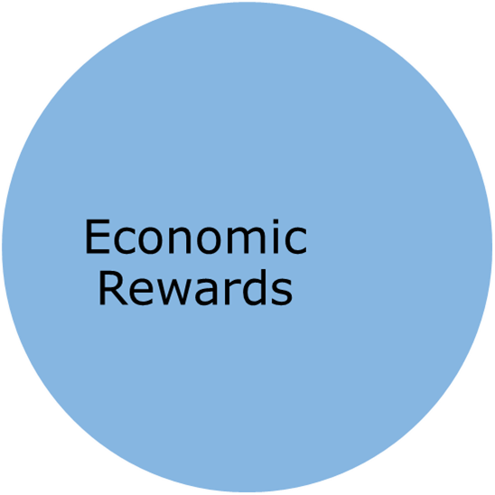
Threefold Classification
Intrinsic Satisfaction
Social Relationship
NEEDS
AND EXPECTATIONS AT WORK

Slide 13
Ten steps to a Happy Workplace
Trust your team
Make your people feel good
Give freedom within clear guidelines
Be open and transparent
Recruit for attitude; train for skill
Celebrate mistakes (No-blame culture)
Community: create mutual benefit
Love work, get a life
Select managers who are good at managing
Play to your strength.

Slide 14
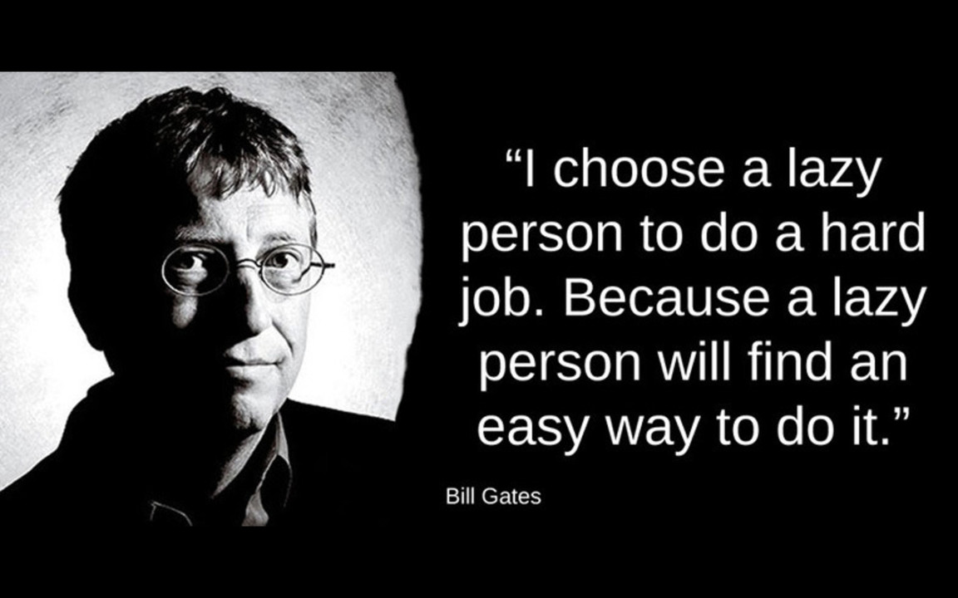

Slide 15

I don't do 100% research. I do 70% research and if I get DO vibe, then I do and rest 30% I will learn during execution and working forward.

Slide 16
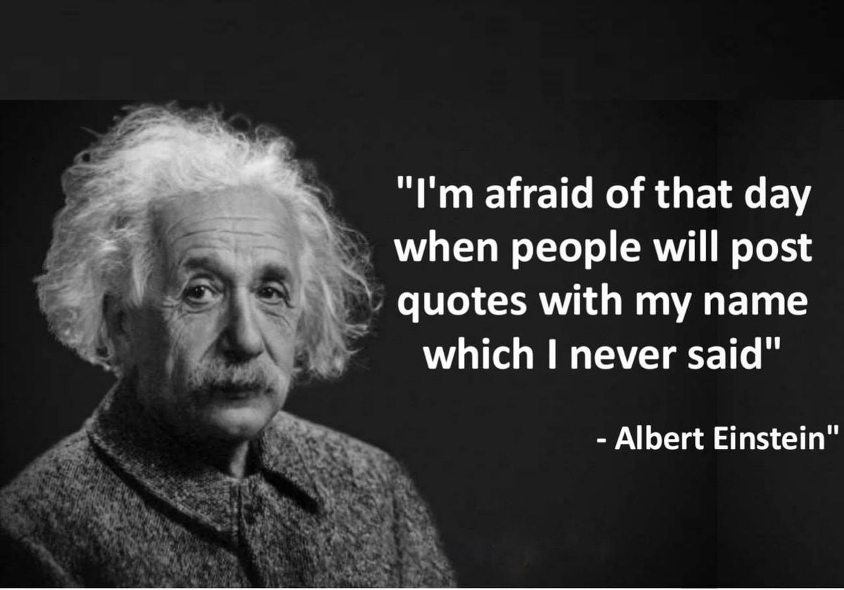
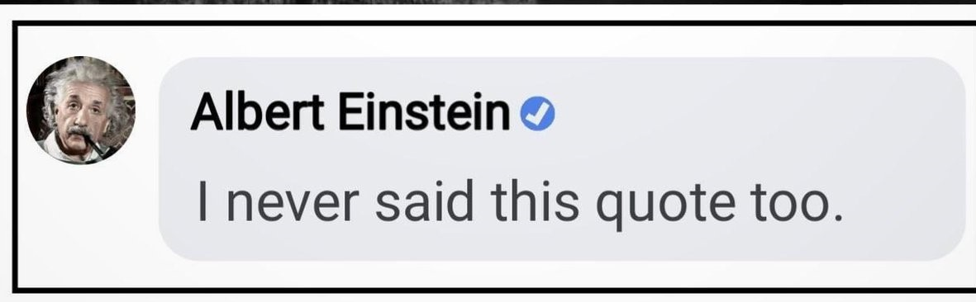

Slide 17

If you are always trying to be normal, you will never know how AMAZING you can be.
Maya Angelou – American Poet

Slide 18
Theories of Motivation
Content Theory
Maslow’s hierarchy of needs theory
Alderfer’s modified need hierarchy model
Herzberg’s two-factor theory
McClelland’s achievement motivation theory
Nohria’s four-drives model of motivation
Process Theory
Expectancy Theory
Equity Theory
Goal Theory
Attribution Theory

Slide 19
Maslow’s Hierarchy of Needs Theory
Human needs are arranged in series of levels, a hierarchy of importance.
People are wanting beings
They always want more
Their want depends on what they already have.

Slide 20
Nine innate Needs including drives and goals identified by Maslow
Self-actualization
Need to develop our full potential
Freedom of enquiry
And expression
Need that is prerequisite for satisfaction of other needs
Transcendence
A spiritual need, ‘to be one at one with universe’
To know and to understand
Need to gain to systematize knowledge, the need for curiosity, learning, philosophizing, experimenting and exploring

Slide 21
Aesthetics
Need for order and beauty
Esteem
Need for strength, confidence, achievement, self-esteem, independence, reputation, prestige, recognition, attention, appreciation and the respect of others
Affiliation
Need for attachment, belongingness, affection, love, relationships
Safety
Need for security, comport, freedom from fear, shelter, predictability, and an organized world
Biological
Need for sunlight, food, water, rest, oxygen –needs basic to our survival

Slide 22
Safety
Psychological
Self-
Actualization
Esteem
Love
Maslow’s Hierarchy of Needs Model

Slide 23
Herzberg’s Two-Factor Theory
Hygiene and Motivating Factors
Motivation and Job Satisfaction

Slide 24
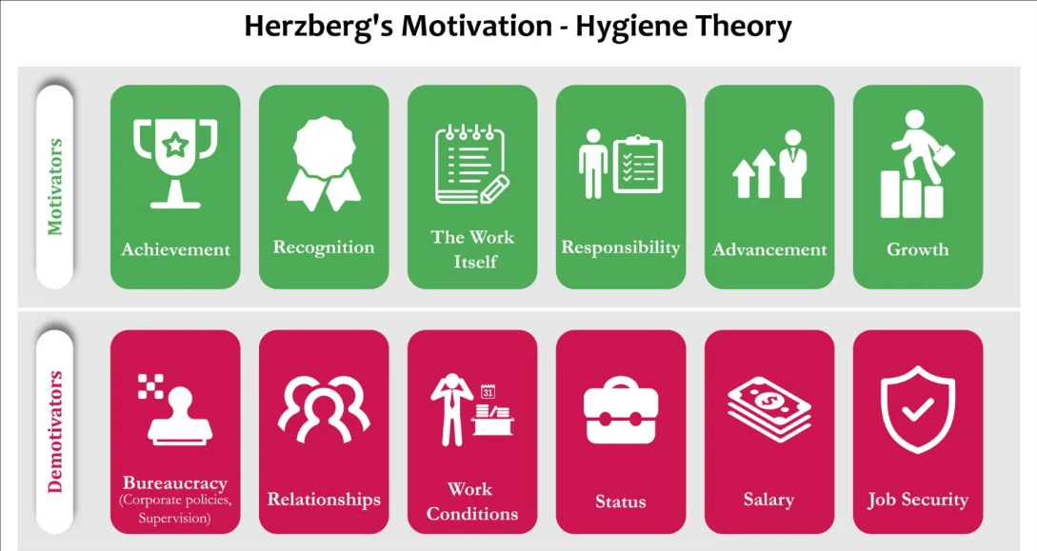
What is Two Factor Theory

Slide 25
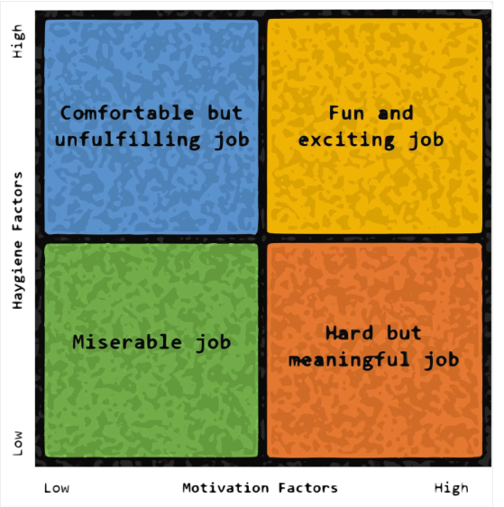
Herzberg’s Approach

Slide 26
Hygiene or Motivating Factors
Salary
Job Security
Supervision
Working Conditions
Company Policy and Administration
Interpersonal Relations

Slide 27
Motivation Factors
Advancement
The work itself
Possibility for growth
Responsibility
Recognition
Achievement

Slide 28

Sometimes dreams .
are wiser than waking.
Black Elk – Oglala Sioux Medicine Man

